Slide 1
Emotional based media playback and stress monitoring system for Autism
TEAM MEMBERS:
SREENIDHYEE E (2018PECCS212)
SRINITHEKA T (2018PECCS215)
SUVETHA J (2018PECCS220)
PROJECT GUIDE:
Mrs. A KANCHANA

Slide 2


Machine learning & iot
DOMAIN:

Slide 3
ABSTRACT
Nowadays Autism children find it difficult to interact socially with people's emotions and make themselves isolated.
This project proposes Emotion detection for Autism spectrum disorder children (ASD).
It is self-possessed of python libraries Open CV, Haar-cascade method to predict faces prediction.
And for better involvement of the children’s social behaviour, here a face is captured in real-time and emotions are predicted by Facial expression recognition (FER).

Slide 4
ABSTRACT
This proposed system helps to improve Autism children behaviour as they often observe their facial expressions and predict the facial emotion. The main objective of this system is to capture an image in real-time and then recognize whether it is a human face using the Computer Vision technique.
If the Predicted facial Emotion is sad, then we will play some Interesting Audio to them using AT mega Microcontroller, which will keep them relaxed and will help them to learn interactively.
Along With that we have designed and built a stress sensor based on Galvanic Skin Response (GSR), to find their stress level and monitoring it via over the Internet Using NodeMCU (ESP8266-12E Microcontroller unit).

Slide 5
EXISTING SYSTEM
CONCEPT : As with any student, children with autism benefit most when teachers and parents are on the same page and efforts in the home and at school are mutually supportive (Organization for Autism Research). Before planning a lesson, the teacher should first meet with parents to discuss the possibility of a class lesson about autism. It is important to get parent input, and if appropriate, input from the student with autism as well.
DISADVANTAGE : The main disadvantages of this system is teacher needs to take care of only one child at a time and sometime this system is not effective.

Slide 6
PROPOSED SYSTEM
CONCEPT:
The main objective of this system is to capture an image in real-time and then recognize whether it is a human face using the Computer Vision technique.
After detecting the human faces from an image, and observe the facial expressions using Deep Neural Network and If the Predicted facial Emotion is happy, then we will play some Interesting Audio to them using AT mega Microcontroller, which will keep them relax and will help them to learn.
Along With that we have designed and built a stress detector using Galvanic Skin Response (GSR).
For this objective, we have to calculate the different conductance of the skin when a person is under stress or when not using Galvanic Skin Response (GSR) device.

Slide 7
PROPOSED SYSTEM
ADVANTAGES:
Cost Efficient
Stress Monitoring
Easy Learning For Kids
APPLICATIONS:
Easy Monitoring
Education field

Slide 8
LIST OF MODULES
Facial Emotion Prediction and Audio Playing module
Hardware Integration module
Embedded C module
Integration of python and Embedded C module
Result and Testing

Slide 9
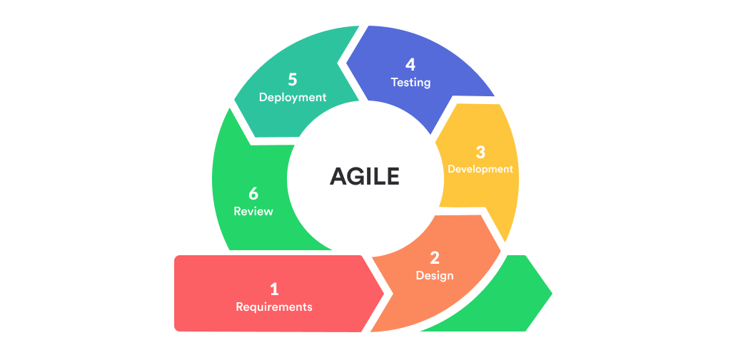
SDLC MODEL
We use Agile Methodology for this project.

Slide 10
TIMELINE CHART
Activity/Time Period | Jan(10-20) | Jan(21-31) | Feb(1-28) | March(1-15) | March(16-31)
Facial Emotion Based Prediction and Audio Playing | ✔
Hardware Integration |  | ✔
Embedded C module |  |  | ✔
Integration of python and Embedded C |  |  |  | ✔
Result and Testing |  |  |  |  | ✔

Slide 11
REFERENCEs
S. Khalifeh, W. Yassin, and S. Kourtian, “Autism inReview,” Lebanese Medical Journal, vol. 64, no. 2,pp. 110–115, 2016.
E. DiCicco-Bloom et al., “The DevelopmentalNeurobiology of Autism Spectrum Disorder,” Journal of Neuroscience, vol. 26, no. 26, pp. 6897–6906, Jun. 2006.
T. W. Frazier et al., “Development of an ObjectiveAutism Risk Index Using Remote Eye Tracking,”Journal of the American Academy of Child &Adolescent Psychiatry, vol. 55, no. 4, pp. 301–309, Apr. 2016.
G. Kouroupetroglou, Ed., Disability Informatics andWeb Accessibility for Motor Limitations: IGI Global,2014.
U. H. Syeda et al., “Visual face scanning and emotion perception analysis between autistic and typicallydeveloping children,” 2017, pp. 844–853.

Slide 12
REFERENCES
Y. M. Al-Farsi, M. M. Al-Sharbati, O. A. Al-Farsi, M.S. Al-Shafaee, D. R. Brooks, and M. I. Waly, “BriefReport: Prevalence of Autistic Spectrum Disorders inthe Sultanate of Oman,” Journal of Autism andDevelopmental Disorders, vol. 41, no. 6, pp. 821–825, Jun. 2011.
V. Eapen, A. A. Mabrouk, T. Zoubeidi, and F. Yunis,“Prevalence of Pervasive Developmental Disorders inPreschool Children in the UAE,” Journal of TropicalPediatrics, vol. 53, no. 3, pp. 202–205, Jan. 2007.
M. AL-zaalah, A. AL-asmari, H. AL-malki, N. AL-shehri, N. AL-moalwi, and O. Mostafa,“Characteristics of Autism Spectrum Disorder amongSaudi Children and its Impact on their Families,”MEDICAL JOURNAL CAIRO UNIVERSITY, vol. 83,no. 2, pp. 239–244, 2015.
F. M. Alnemary, F. M. Alnemary, and Y. A. Alamri,“Autism Research: Where Does the Arab WorldStand?,” Review Journal of Autism andDevelopmental Disorders, vol. 4, no. 2, pp. 157–164,Jun. 2017.

Slide 13
REFERENCEs
S. Swinkels et al., “Screening for autistic spectrum in children aged 14-15 months: Development of the early screening of autistic traits questionnaire,” J. Autism Dev. Disorder., vol. 36, no. 6, pp. 723–732, 2006
E. DiCicco-Bloom et al., “The Developmental Neurobiology of Autism Spectrum Disorder,” Journal of Neuroscience, vol. 26, no. 26, pp. 6897–6906, Jun. 2006.
T. W. Frazier et al., “Development of an Objective Autism Risk Index Using Remote Eye Tracking” Journal of the American Academy of Child &Adolescent Psychiatry, vol. 55, no. 4, pp. 301–309, Apr. 2016.
F. Thabtah and D. Peebles, “A new machine learning model based on induction of rules for autism detection,” Health informatics journal, vol. 26, no. 1, pp. 264–286, 2020.

Slide 14
REFERENCES
R. C. Teepe, I. Molenaar, and L. Verhoeven, “Technology-enhanced storytelling stimulating parent-child interaction and preschool children’s vocabulary knowledge,” J. Comput. Assist. Learn., vol. 33, no. 2, pp. 123–136, Apr. 2017.
H. Zhao, A. R. Swanson, A. S. Weitlauf, Z. E. Warren, and N. Sarkar, “Hand-in-hand: A communication-enhancement collaborative virtual reality system for promoting social interaction in children with autism spectrum disorders,” IEEE Trans. Human-Machine Syst., vol. 48, no. 2, pp. 136–148, Apr. 2018.
Z. Zheng, G. Nie, A. Swanson, A. Weitlauf, Z. Warren, and N. Sarkar, “A randomized controlled trial of an intelligent robotic response to joint attention intervention system,” J. Autism Develop. Disorders, vol. 50, pp. 1–13, Feb. 2020.
U. H. Syeda et al., “Visual face scanning and emotion perception analysis between autistic and typically developing children,” 2017, pp. 844–853.

Slide 15
REFERENCES
W. Liu, M. Li, and L. Yi, “Identifying children with autism spectrum disorder based on their face processing abnormality: A machine learning framework: Face Processing in Autism,” Autism Research, vol. 9, no. 8, pp. 888–898, Aug. 2016.
Yoram S.Bonneh, “Abnormal Speech Spectrum and Increased Pitch Variability in Young Autistic Children”, 12-Jun-2015.
Brett Baisch, Sean Cai, Zongming Li, Victor Pinheiro, “Reaction Time of Children With and Without Autistic Spectrum Disorders”, 03-Jun-2017.
D. P. Wall, J. Kosmicki, T. F. DeLuca, E. Harstad, and V. A. Fusaro, “Use of machine learning to shorten observation-based screening and diagnosis of autism,” Translational Psychiatry, vol. 2, no. 4, pp. e100–e100, Apr. 2012.

Slide 16
Thank you

